Slide 1
General information about D. melanogaster work in Rusten/Fang group
Made by Sofie Lautrup on 13th Jan 2020

Slide 2
Where and who?
Located in Forskningsbygget 6th floor at Radium Hospitalet, Oslo
We share the fly facility with other labs, mainly Tor Erik Rusten’s lab
They own all equipment, pay for fly materials etc. so be careful and wise

Slide 3
Useful open resources
Flybase.org

Slide 4
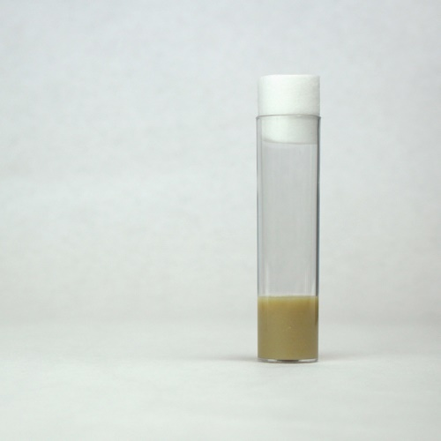
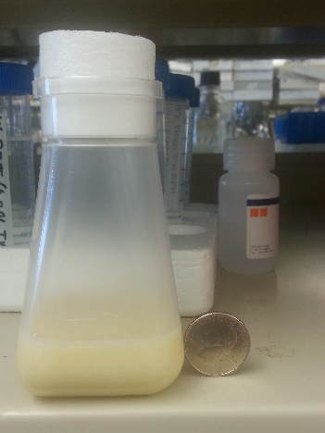
Food is prepared by Tor Erik’s technician and is placed in the cold room
  Note on the sheet in the cool room whether you need a lot
  Note when you will need to flip your stocks and how much food you need
Food is prepared in either small vials or larger bottles
Lids are found in a cabinet in the small room just before entering the fly lab
Dry yeast and plastic ware are in the fly lab.
For pensels, tweezer etc, you need to bring your own (Sofie has for her students only)
Food you take out of the cold room, but do not use has to be put back as soon as you are done in the fly lab. It cannot stay in the fly lab ON.

Slide 5
Food recipe — Prepared by technician in Rusten lab
1 L distilled water
13 g agar
22 g molasses
65 g malt extract
18 g brewer’s yeast
80 g corn flour
10 g soy flour
6.2 ml propionic acid
2 g methyl-p-benzoate in 7.3 ml of EtOH
For drugs used by Sofie:
RU-486 (mifepristone): stock 20 mM in EtOH, final in reaction 200 uM
NR, NMN: dissolved in water
UA: dissolved in DMSO

Slide 6
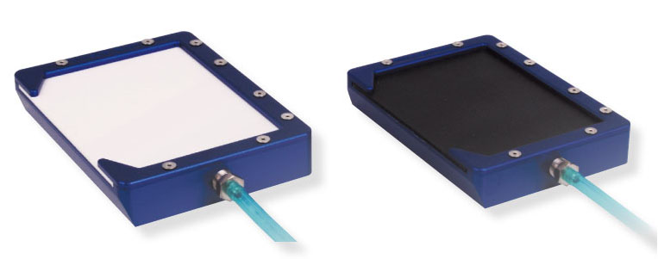
When using the fly lab always clean with EtOH after use.
This encounters your own equipment (tweezers, pensels etc.)
Fly pads, guns, microscope, table etc.
In this way, we will avoid contaminations as best as possible.

Slide 7
Flipping and flipping frequency
The frequency that you need to flip the flies depends on temperature of storage and what you will use the flies for.
Flipping means to transfer the flies from one vial to another.
For 18 C stocks:
2 vials of each strain are kept at 18C.
At 18 C the life cycle of the flies are slower, why we do not have to flip so often.
One of the vials is flipped every 2-weeks, so that each vial is flipped once per 4-5 weeks.
We keep stocks at 18C, since flies can not be recovered from freezing.
Flies at 25C:
At 25C the cycle from egg to adult fly is 10 days.
Working stocks: flip 2-3 a week
Stocks wherefrom virgins are needed: flip 3 times a week, add yeast to the bottles.
Crosses: flip 3 times a week, add yeast.

Slide 8
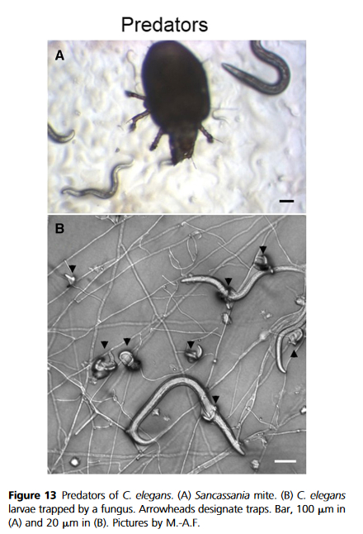
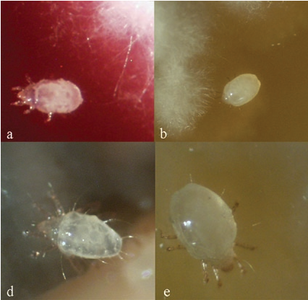
Contaminations
Strain vs. strain contamination. How to avoid?
Fungi and bacteria
Mites (Tyrophagus putrescentiae, or Sancassaniamite)
Reference: https://www.ncbi.nlm.nih.gov/pubmed/28476862
Video of a mite: https://www.youtube.com/watch?v=l6OMq7vDqdA

Slide 9
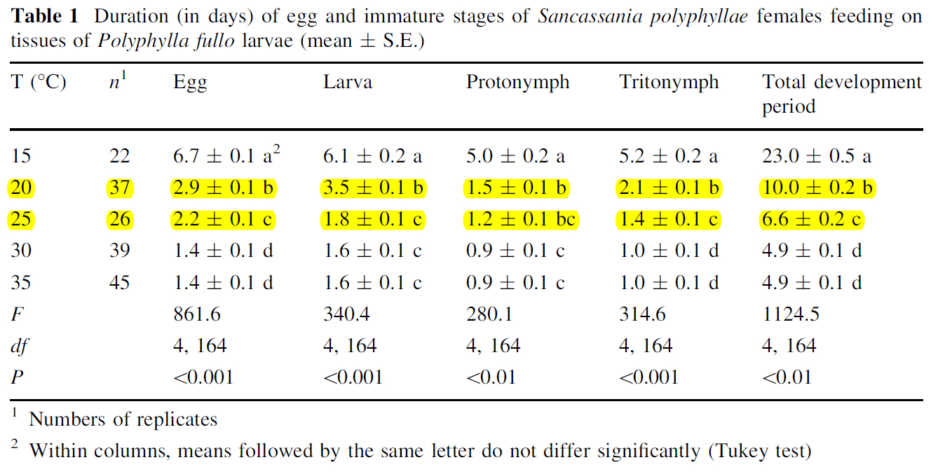
The life history of mite (e.g., Sancassania polyphyllae)
Reference: Cakmak I. et a., Exp. Appl Acarol, 2011

Slide 10
Cleaning contaminated fly vials
The most normal types of contamination:
Bacterial contamination:
Can in general be avoided by flipping flies regularly and having enough flies in the vials.
If it happens, best to throw out the vial.
If the vial cannot be thrown out, you can treat with Penicillin/streptomycin, but it has to be for at least 2 full generations.
  If the treatment is too short, you risk creating resistant bacteria.
  If it is too long, you risk to affect your flies.
  Do not do your experiments with P/S treated flies.
Mite contamination:
Mite contamination are more common in the fly lab, than in the C. elegans lab. Though, still as serious.
If you see mites in/on your fly vials – tell Sofie.
Mites will eat the pupaes and flies and therefore they cannot be used for either stocks, crosses or experiments.
The easiest way to avoid mites are:
  To flip regularly
  To change the cardboard boxes with the vials regularly (at least once per month)
  To check you vials regularly
  Not to store old vials in the incubators!
If you get a mite infection – best to throw out the infected vials.
There is a drug you can use, but it is also very toxic to the flies.
Quarantine incubator
In an attempt to avoid most contaminations, we have a quarantine incubator.
When new vials with flies are received, they should be placed in the quarantine incubator at least 20 days. During this time, you should make sure that there are no contamination in your vials.
If there is, better to throw out.

Slide 11
Genetic Nomenclature https://www.ncbi.nlm.nih.gov/books/NBK20203/
WRN human
Wrn^{-/-} mouse wrn-1 (gene) C. elegans (WRN-1 protein)
WRNexo (gene) D. melanogaster

Slide 12
Videos for drosophila methods https://www.jove.com/encyclopedia-of-experiments/category/1/drosophila-melanogaster-fruit-fly

Slide 13
Acquiring strains from the Bloomington or VDRC
Bloomington
https://bdsc.indiana.edu/
VDRC
With VDRC you need to pay with your own credit card, then do a reimbursement.
Never order without confirming with Evandro first.
https://stockcenter.vdrc.at/control/main

